Slide 1
Projektseminar Eingebettete Systeme
Topic: Early warning systems for seizure detection
Winter Semester 2023/24 Hossein Safakish

Slide 2
Agenda
. Introduction and Motivation
. Seizure detection and ways
. Advantages and Disadvantages
. Seizure prediction and ways
. Combination of ways
. Closed-Loop systems
. Practical work
. Best way to implement analytical method for Embedded systems
. Challenges
. Conclusion

Slide 3

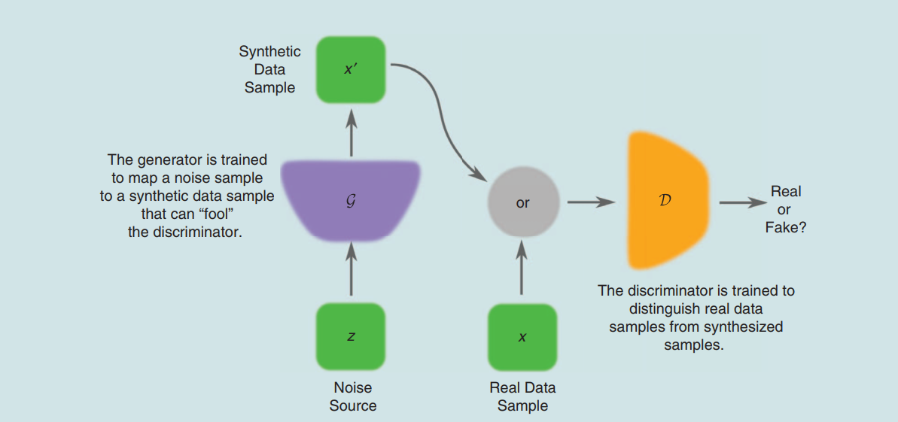
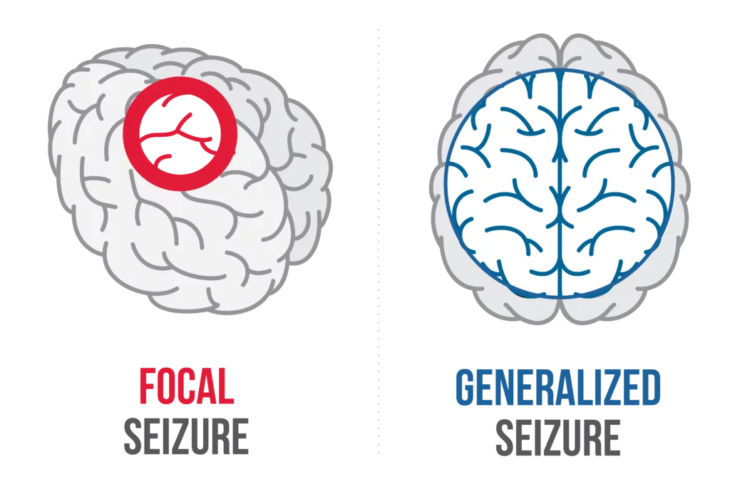
Tonic,….
Introduction and Motivation
One of the most common neurological disorders
Focal and Generalized
The quality of patient’s life
One-third of patients
The main motivation:
- Mitigate or even prevent seizures
Figure 1. Occurrence of seizure [1]
Figure 2. Focal and generalized seizure [2]

Slide 4
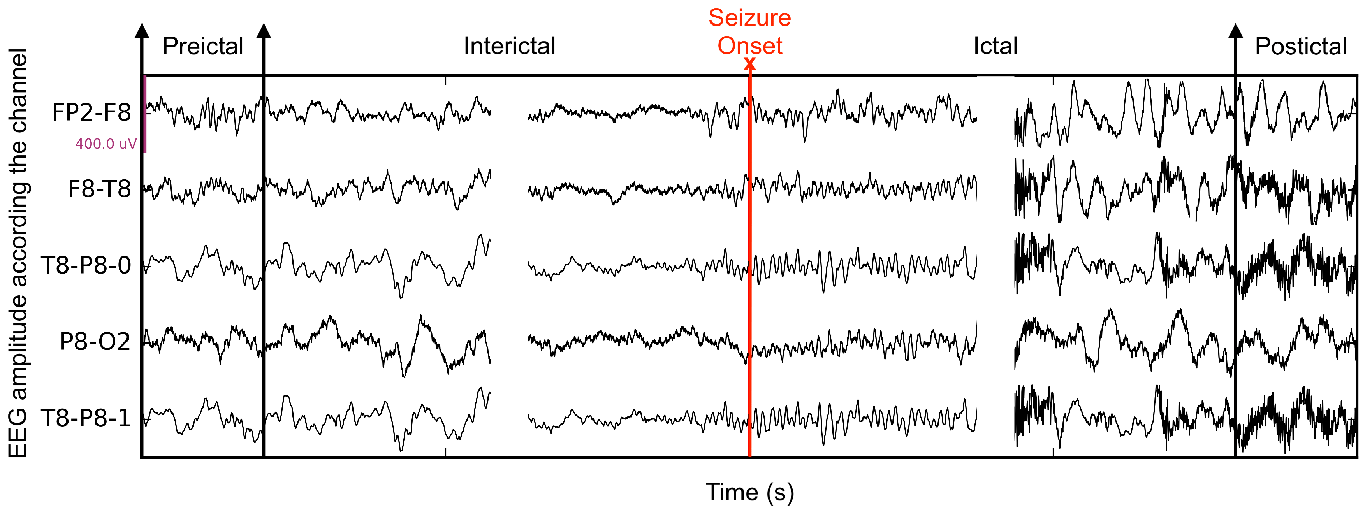
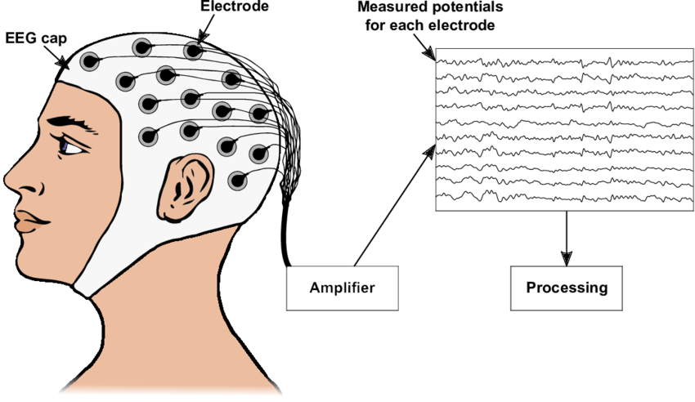
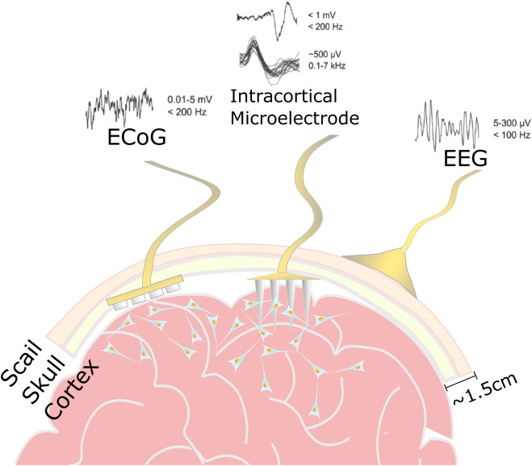
Begoo faza chian
Seizure detection and ways
1. Electroencephalogram (EEG)
2. Electrocorticography (ECoG)
- Electrode grid is positioned on the exposed brain cortex.
Figure 3. EEG Electrode [3]
Figure 4. EEG Record [4]
Figure 5. ECoG Electrode [5]

Slide 5
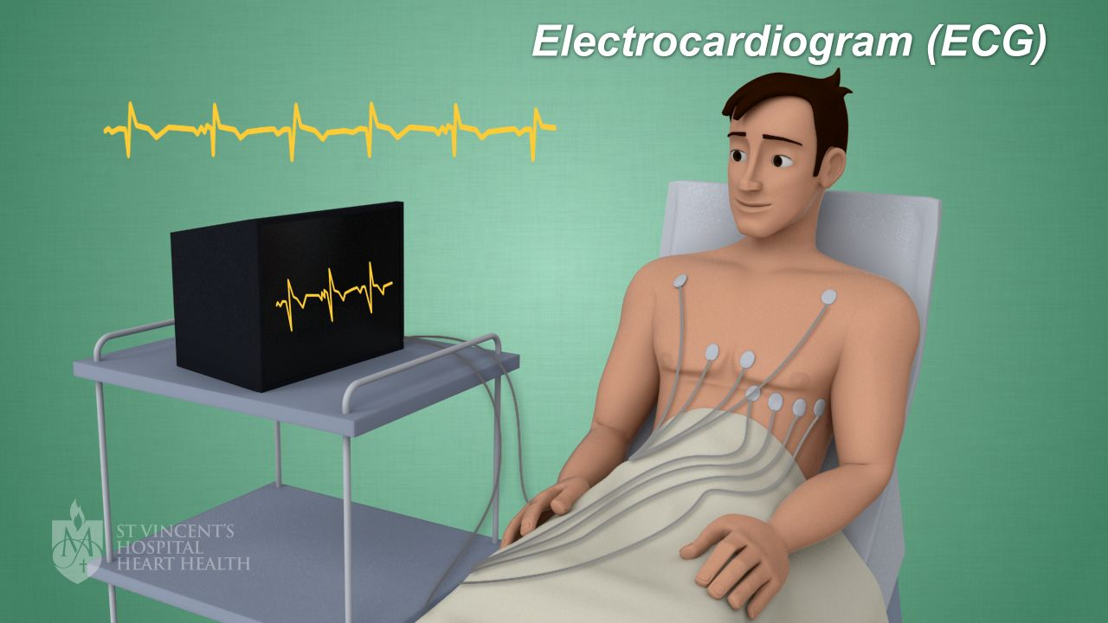
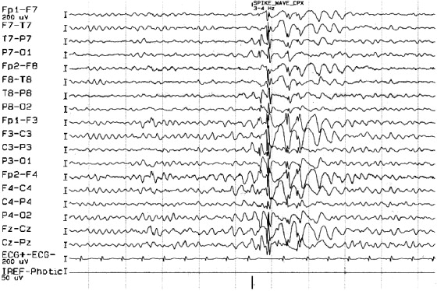
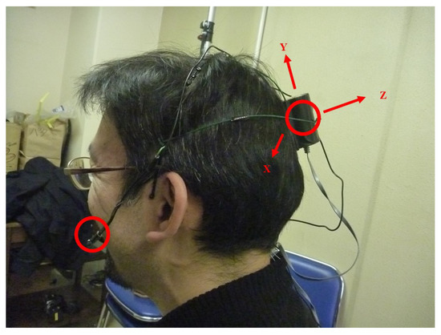
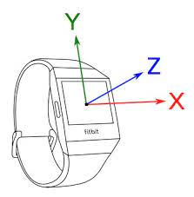
Seizure detection and ways
3. Electrocardiography (ECG)
4. Accelerometry
- Measuring and recording acceleration or movement patterns
- Suitable for motor seizures (tonic-clonic or myoclonic)
- Tachycardia (increased heart rate)(tonic-clonic seizures) - Bradycardia (decreased heart rate)
Figure 6. ECG Record [6]
Figure 7. ECG Electrode [7]
Figure 9. Accelerometry [9]
Figure 8. Accelerometry [8]

Slide 6
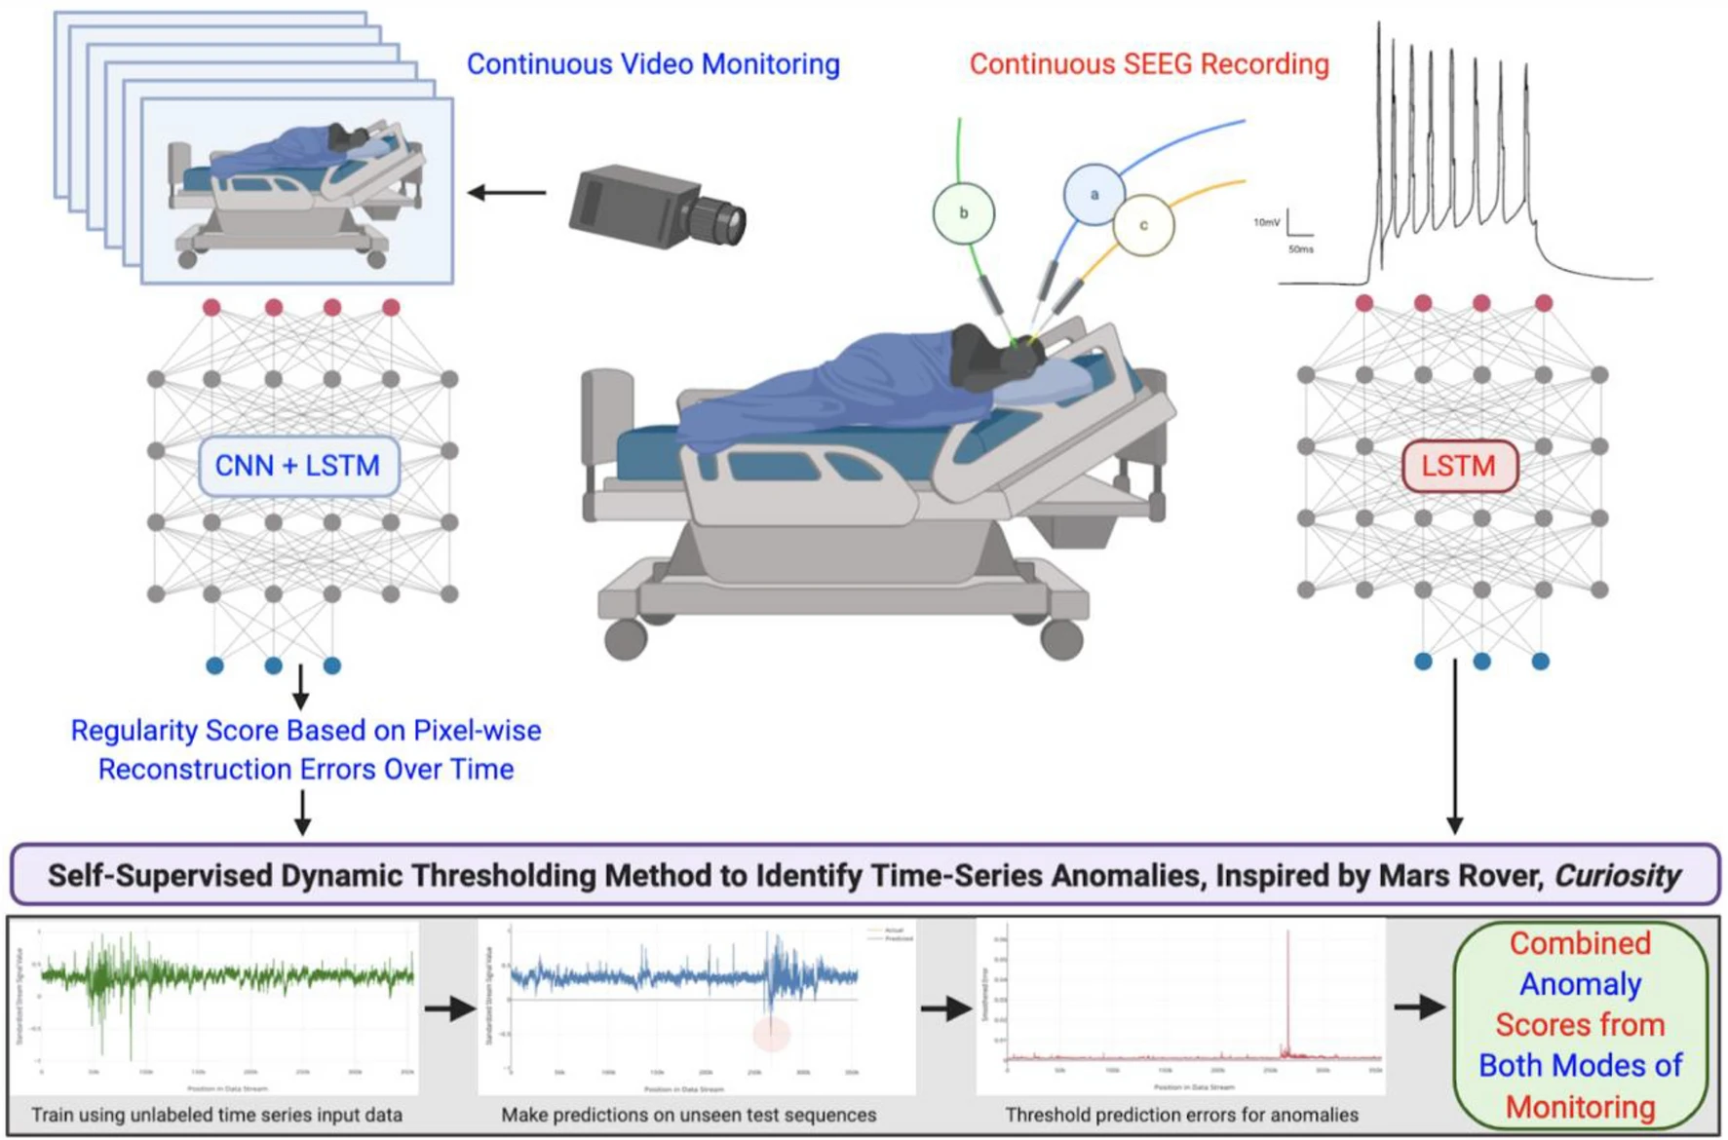
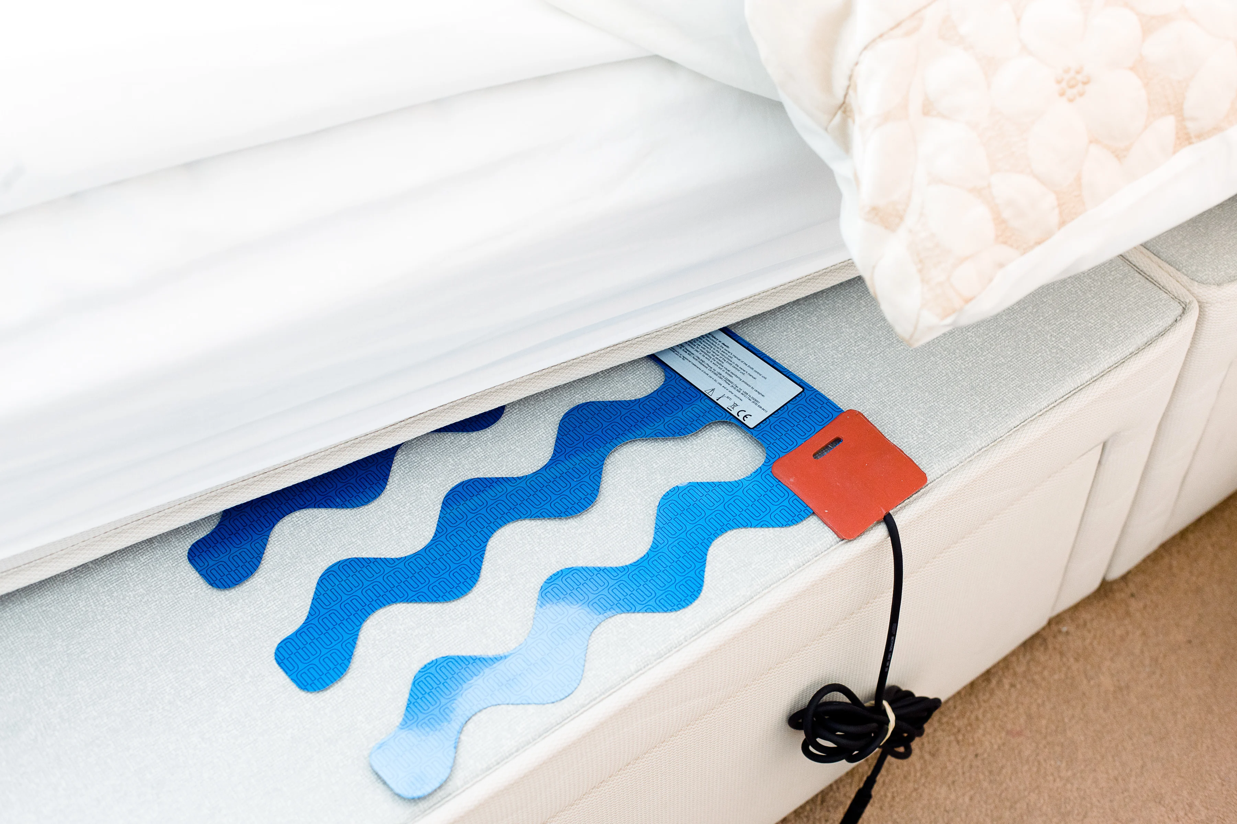
Seizure detection and ways
5. Video detection
Motion trajectory methods track the path of moving objects over time.
6. Mattress sensor This is used to detect tapping and spring noise, aiming to detect seizures during sleep.
Figure 10. Video detection [10]
Figure 11. Mattress sensor [11]

Slide 7
Advantages and Disadvantages
Methode | Advantage | Disadvantage
Electroencephalography (EEG) | Noninvasive with valuable data in detecting epileptic seizures. | Low spatial resolution
Electrocorticography (ECoG) | More accurate compared to EEG | Invasive procedure
Electrocardiogram (ECG) | Narrow relation of tachycardia in preictal phase | Rhythmic cardiac changes can be observed in other physiological and pathological conditions, especially in older patients
Accelerometry | Able to detect movement changes in x, y, and z planes. Used in seizures with motor component. | Any sudden movement can be registered as a seizure event
Video detection systems | Recognizing kinematic patterns of seizure | Miss the seizure when patient is under covers or out of the camera's range
Mattress sensor | Nocturnal seizures, especially tonic–clonic seizures. | High negative predictive value
Table 1. Advantages and Disadvantages of the ways [15]

Slide 8
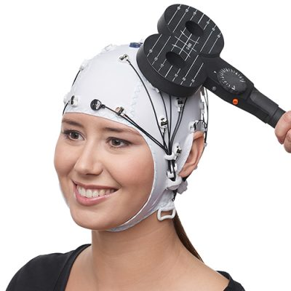
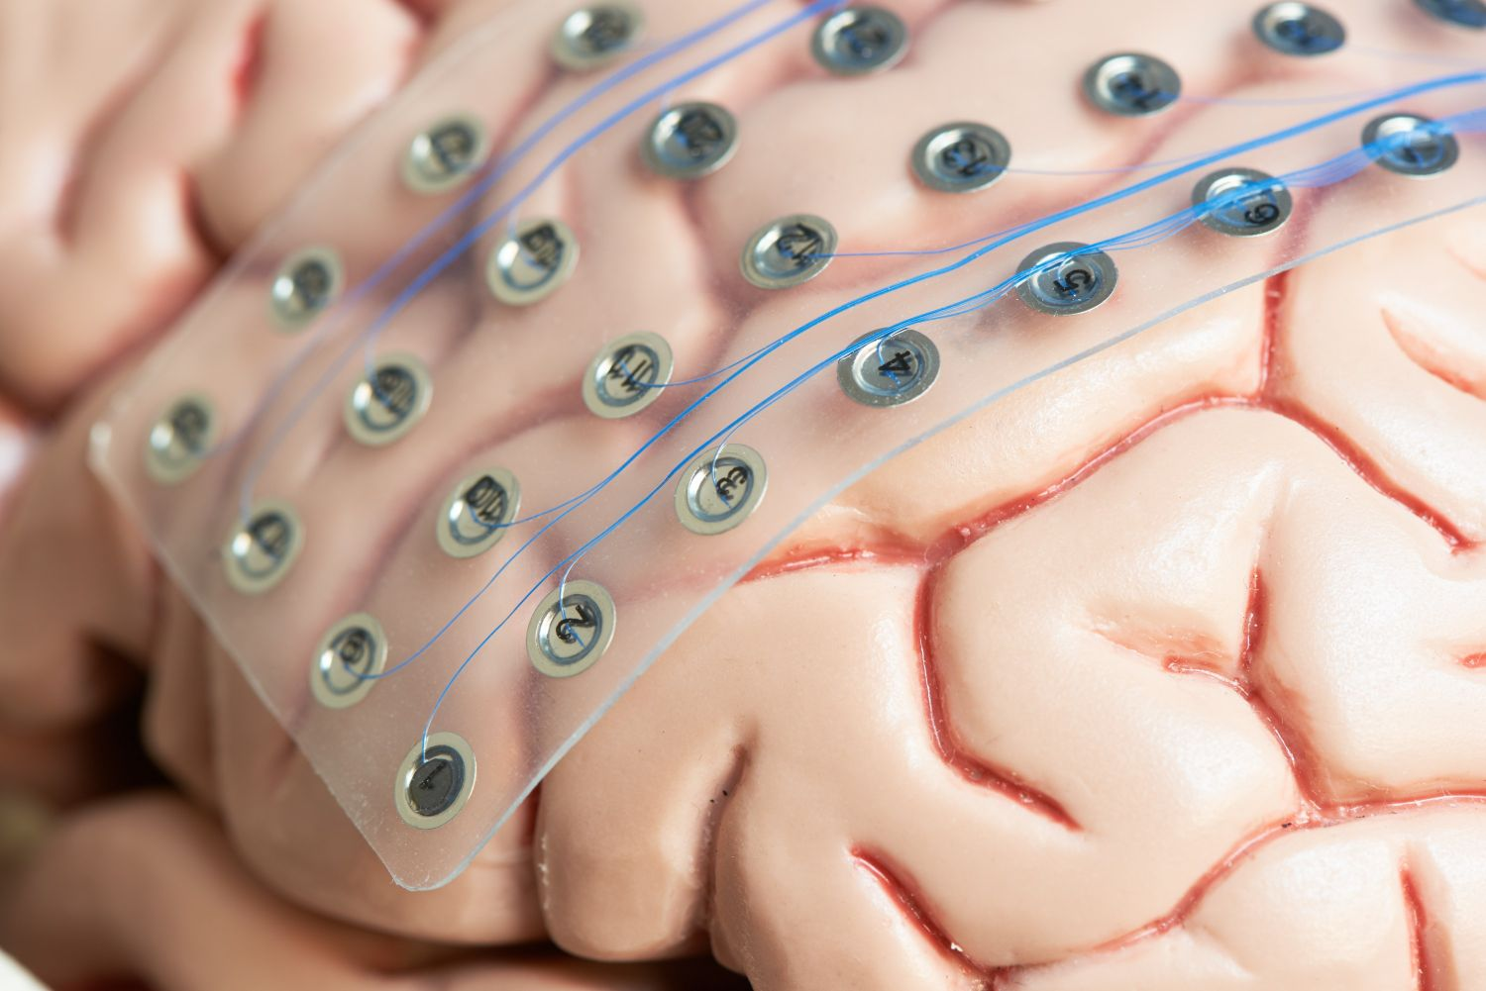
Seizure prediction and ways
- Prevent accidents, improve outcomes, and enable early treatment or even seizure prevention - Preictal phase
- EEG and ECoG: 7 hours before a seizure, classification with SVM or ANN is necessary.
- Electrical probing of cortical excitability:
Transcranial EEG
poorly tolerated by patients
- Long-term implanted advisory system:
Intracranial EEG
Figure 12. Transcranial EEG [12]
Figure 13. Intracranial EEG [13]

Slide 9
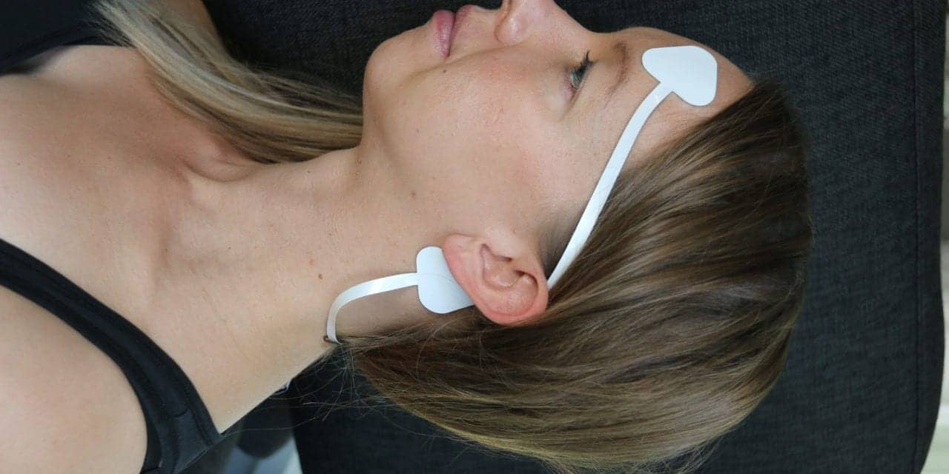
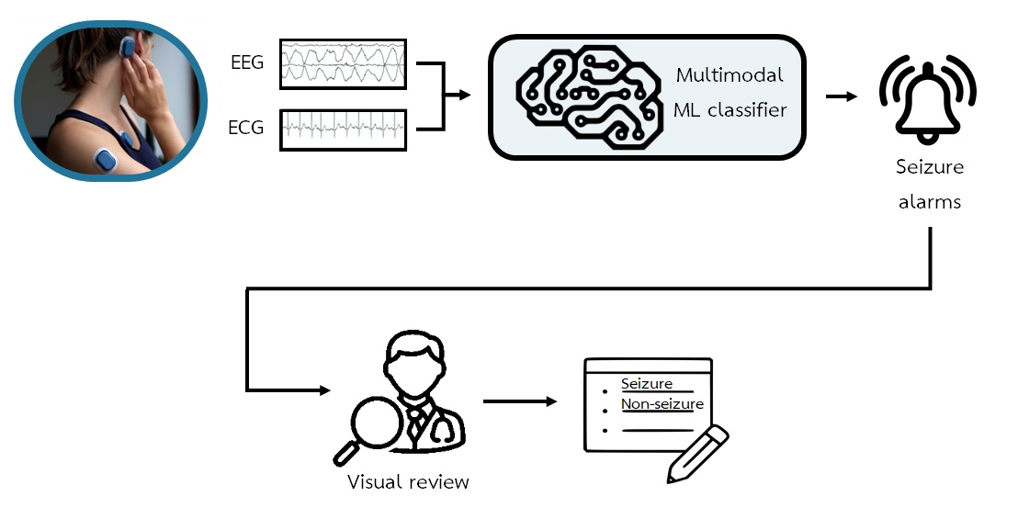
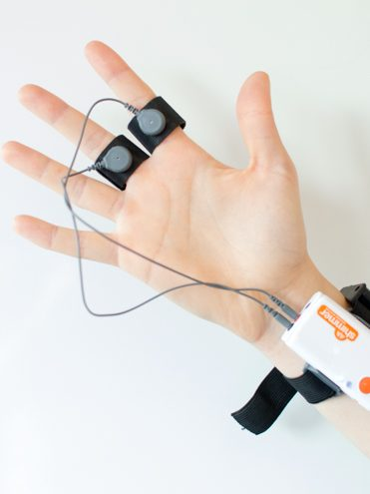
Begoo kodom pred kodom detect
Combined ways
- Combined EEG:
single EEG channel and multiple EEG channels
- EEG and ECG
- Accelerometry and
Electrodermal (sweat secretion)
(related to postictal)
Figure 16. single EEG channel [16]
Figure 3. multiple EEG channels[3]
Figure 17. Electrodermal [17]
Figure 14. Combined EEG and ECG [14]

Slide 10
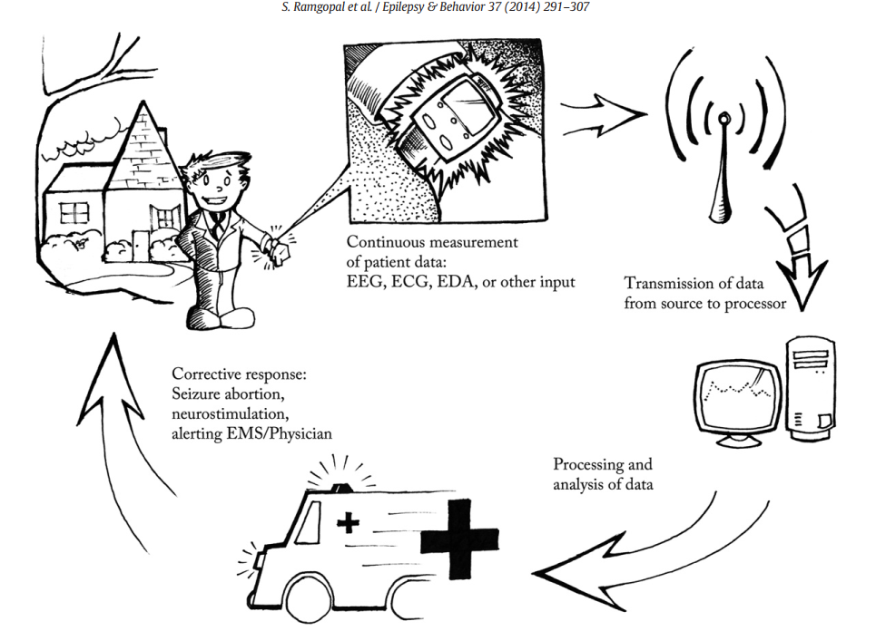
Begoo processing baray part baad
Closed loop systems
Measuring device:
Like a smartwatch & Wearable EEG,…
2. Data transmission:
WiFi or Bluetooth
Privacy and safety
3. Data processing:
Data processing is crucial for interpreting the signals collected by the biometric device and assessing the patient's seizure risk in real-time.
4. Response system:
Warn patients, caregivers or emergency services.
Local drug delivery systems:
RNS (deliver electrical pulses)
(rapid-acting benzodiazepines)
To relieve
Figure 15. Closed loop systems [15]

Slide 11
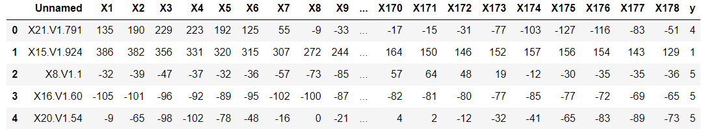
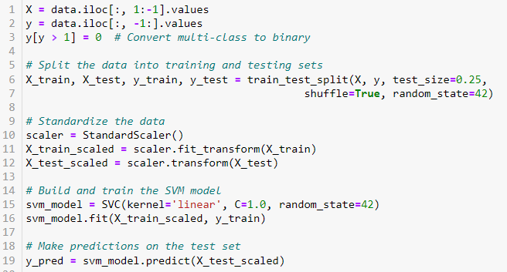
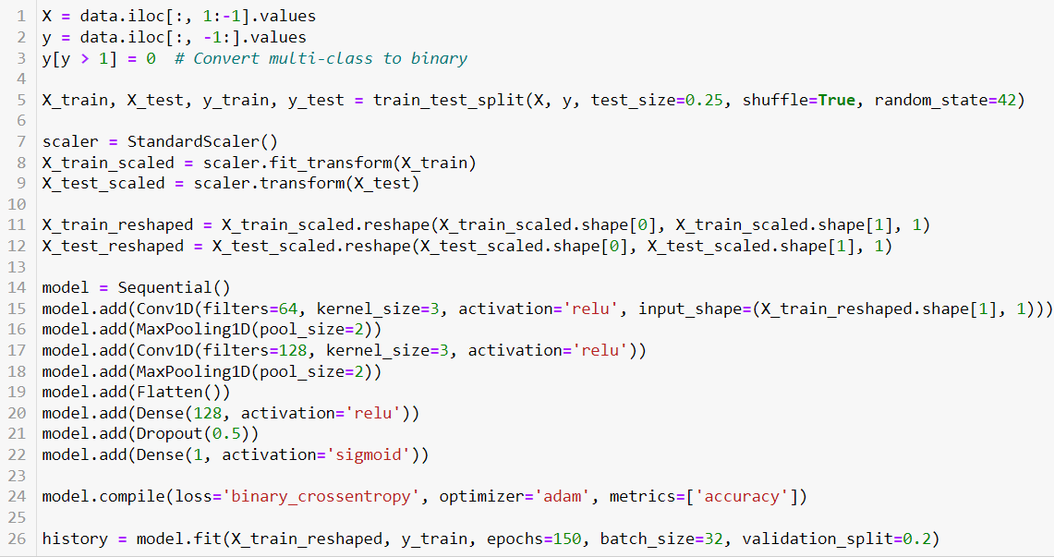
Practical work
Data visualization
SVM
CNN

Slide 12
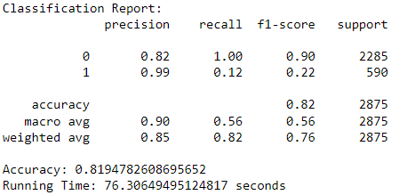
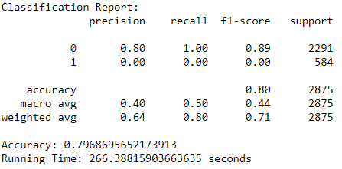
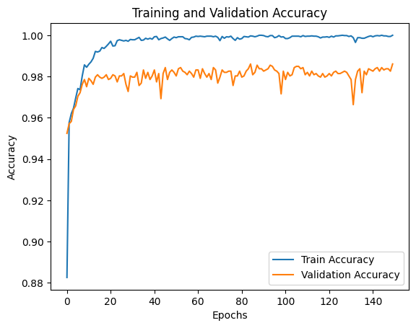
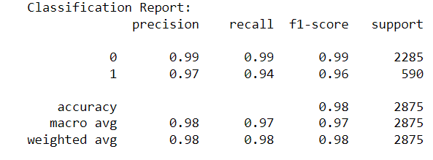
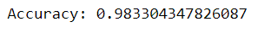
Practical work
SVM
DNN
CNN

Slide 13
Best way to implement analytical method for Embedded systems
- Requirements of an embedded system (like closed loop systems)
- While algorithms such as SVM, DNN, CNN, etc., can meet the requirements, complex algorithms with high computational demands may not be suitable.
- Use SVM for detection, and CNN for prediction.
- Optimizing energy consumption: hardware selection, model architecture, and batch size, etc..

Slide 14
Challenges
- Accuracy
- Real-time data transfer
- 24-hour service availability
- Establishing collaborations
- Validating technology (test) - Safety and effectiveness
Technical
Regulatory
- Market needs & Costs - Maintenance - Return on investment
- CIMIT
- Epilepsy Therapy Project
Market
Funding

Slide 15
Conclusion
Detection emergency cases
Prediction aborting the seizure & accidents
Combined ways increase specificity & accuracy
Best approach closed-loop systems

Slide 16
References
[1] https://www.1mg.com/articles/national-epilepsy-day-7-common-epilepsy-myths-busted/
[2] https://www.cureepilepsy.org/for-patients/understanding/basics/what-is-seizure/
[3] https://www.researchgate.net/figure/Sketch-of-how-to-record-an-Electroencephalogram-An-EEG-allows-measuring-the-electrical_fig1_338423585
[4] https://www.mdpi.com/2076-3417/11/4/1579
[5] https://www.sciencedirect.com/science/article/abs/pii/S2352492821008412
[6] https://ars.els-cdn.com/content/image/1-s2.0-S1567423103030132-gr2.jpg
[7] https://www.svhhearthealth.com.au/Images/UserUploadedImages/974/06_ECG.jpg
[8] https://encrypted-tbn0.gstatic.com/images?q=tbn:ANd9GcSlNBE3omgK3jYnBWVbTFSo_CfH9NirtWhkcznc8upKSVSTFNNejNNqyX9Do349wLmedHM&usqp=CAU
[9] https://www.mdpi.com/1424-8220/21/9/3162
[10] https://www.nature.com/articles/s41598-021-86891-y
[11] https://www.tunstall.co.uk/our-products/product-catalogue/epilepsy-sensor/
[12] https://pressrelease.brainproducts.com/tms-eeg/
[13] https://www.gillettechildrens.org/your-visit/patient-education/invasive-eeg
[14] https://www.mdpi.com/2306-5354/10/4/491
[15] Ramgopal, Sriram, et al. "Seizure detection, seizure prediction, and closed-loop warning systems in epilepsy." Epilepsy & behavior 37 (2014): 291-307.
[16] https://sleepreviewmag.com/sleep-diagnostics/in-lab-tests/polysomnography/using-a-single-eeg-channel-researchers-new-deep-learning-model-diagnoses-osa-with-82-9-accuracy/
[17] https://imotions.com/blog/learning/research-fundamentals/eda/

Slide 17
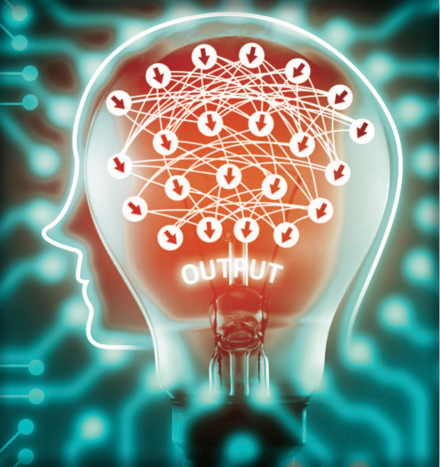
Thank You
©Istockphoto.com/zapp2photo

